Slide 1
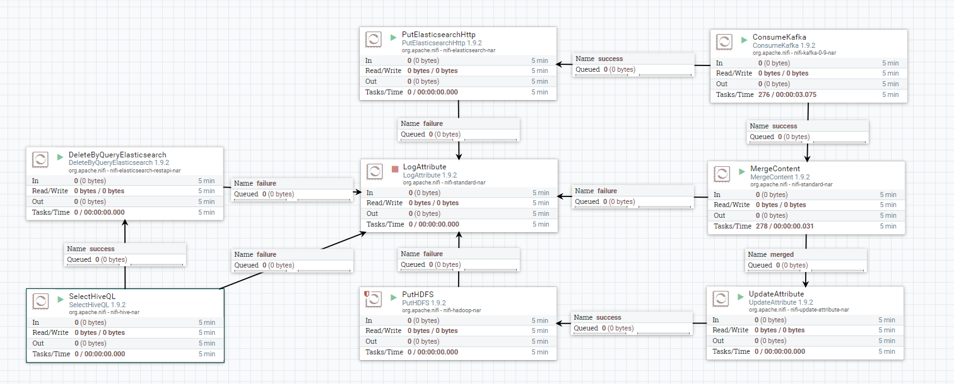
Nifi Processors

Slide 2
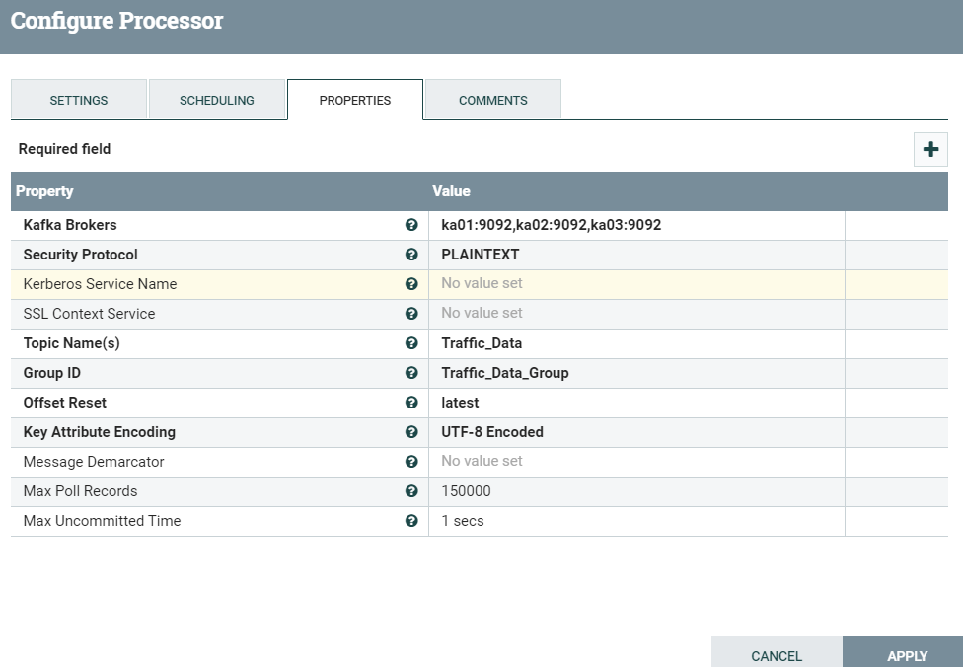
1. ConsumeKafka

Slide 3
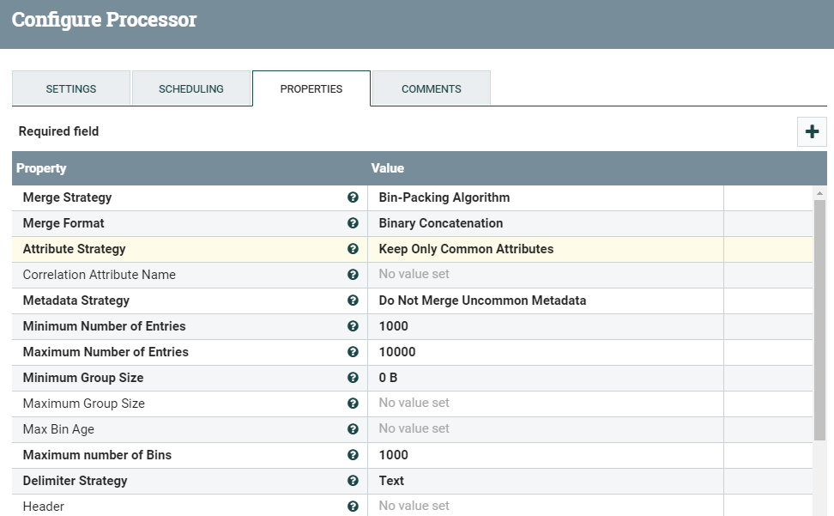
2. MergeContent

Slide 4
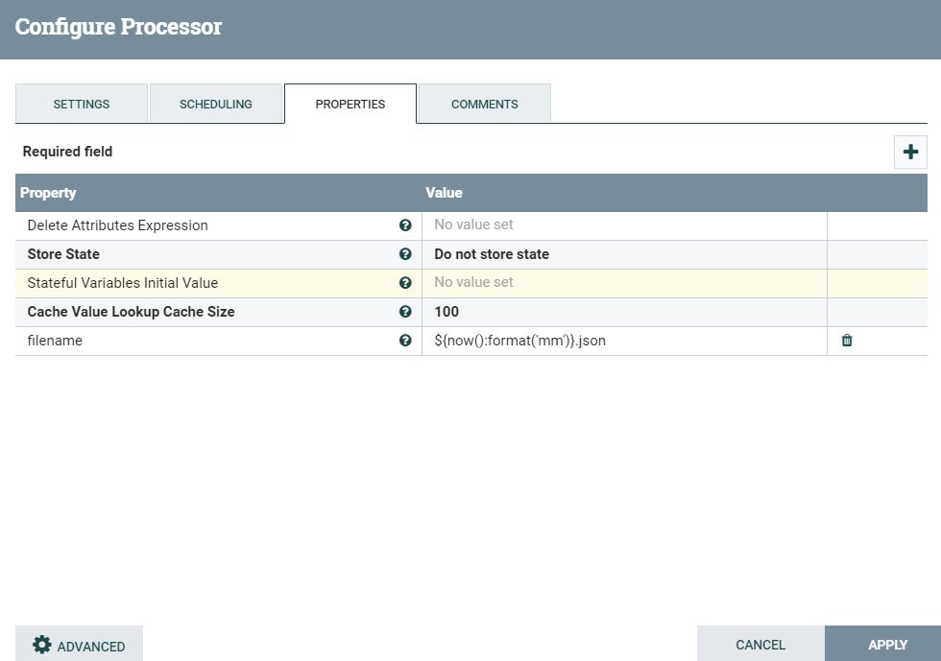
3. UpdateAttribute

Slide 5
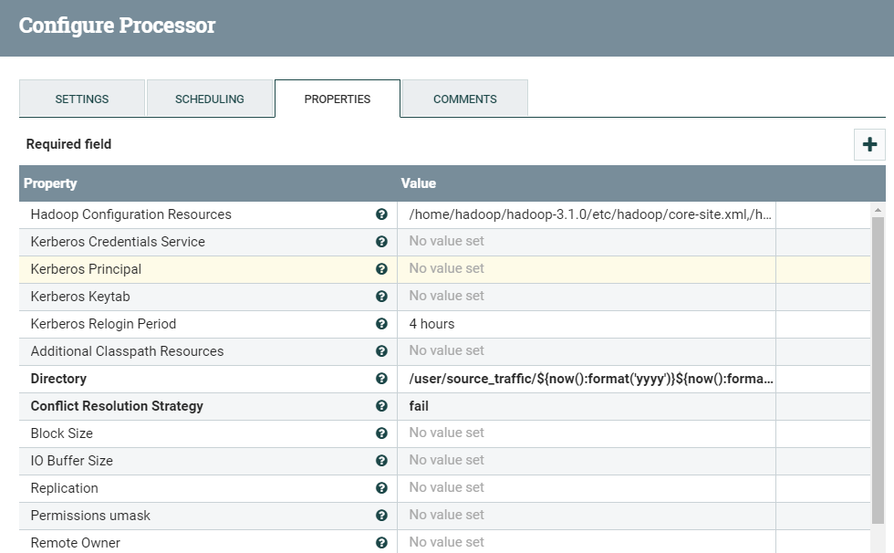

4. PutHDFS

Slide 6
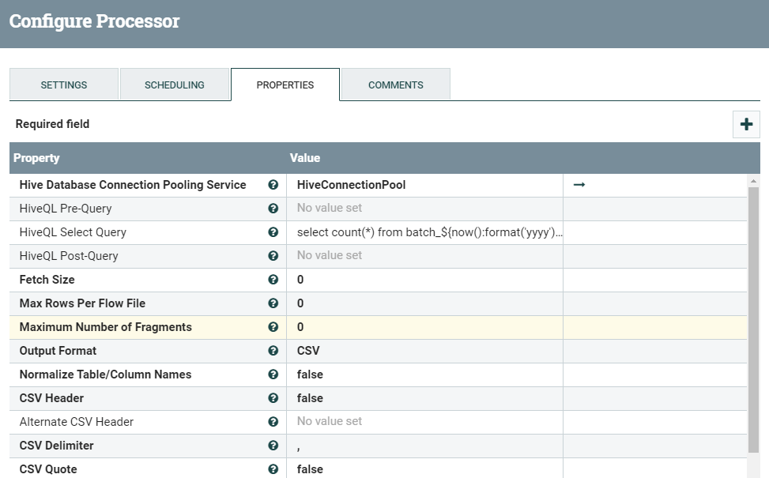

5. SelectHiveQL

Slide 7
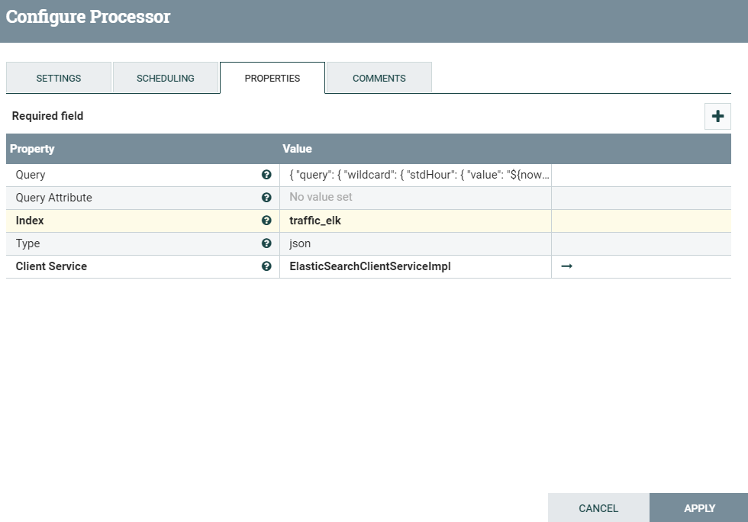
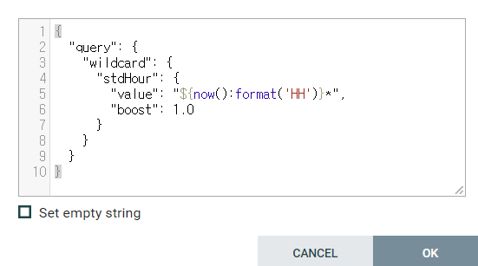
6. DeleteByQueryElasticsearch

Slide 8
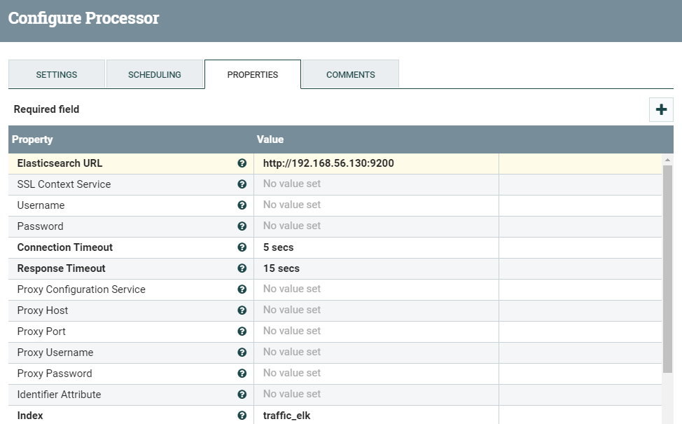
7. PutElasticsearchHTTP

